Slide 1

Bridging the Gap between Industry and Academia
Research Based Training

Slide 2
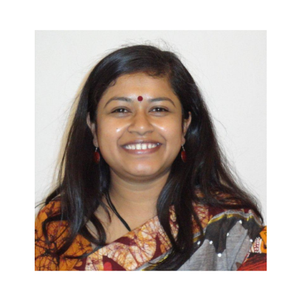
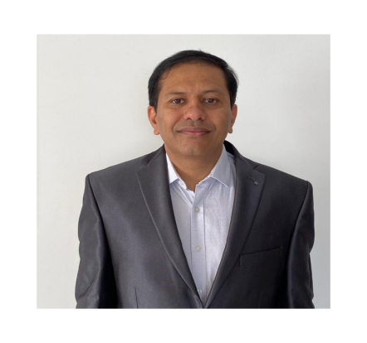

Meet The Directors
Ekata Mehul
Mr. Ketan Manvar
Principle Director
Director
Ekata Mehul, Director and CEO – Blazing Arrows Pvt. Ltd.; 25 years of experience in Industry & Academia; Board of Studies for various Universities; Ph. D. (Wireless Sensor Networks) (Education); M. Tech (ICT). B. Tech. (Comp.). Patent – “digital metering using Zigbee Technology’”, chapters in Books, Papers Publications. Nominated as “Women Entrepreneur Gujarat by GESIA”; IVLP Alumni in US for ‘Women in Technology”; “Traveler” for Arkansas state, US. Subject Matter Expert and Master Trainer – ESSCI, SSC NASSCOM. Executive member for “Computer Society of India, Baroda Chapter”, Core Committee in Vadodara HR Forum, life member for NASSCOM, ISTE, IETE. Director for “Women in Big Data, India”. An Educator & Blissful Human being
Ketan Manvar Director and CEO of Reliable Control Systems Pvt. Ltd, Orena Solusions; with 20Years of experience in the field of Design, Development and Manufacturing of Instrumentation Product For Automation and Control, With 150 Corporate Clients, Currently Running Relcon Systems, Unitech Technocrates Pvt. Ltd, Touch Controls.
Completed Bachelor Engineering Degree in Instrumentation and Controls from DDIT.
Focused on New Technology development in the field of automation and control.

Slide 3
Our Vision
ACKNOWLEDGEMENT
If words are considered as a symbol of approval and token of appreciation then let the words play the heralding role expressing my gratitude.
The satisfaction that accompanies that the successful completion of any task would be incomplete without the mention of people whose caseless cooperation made it possible ,whose constant guidance and encouragement crown all efforts with success. We are grateful to our project guide for the guidance ,inspiration and constructive suggestions that helpful us in the preparation of this project. We also thank our colleagues who have helped in successful completion of the project.

Slide 4
Our Vision
TABLE OF CONTENTS:
Our vision is to create an ecosystem to equip, empower and encourage the Human Talent as well as companies to contribute towards the country’s development through specific, customized and relevant research based training & mentoring programs as well as Product development, mainly in the Engineering Domain.
Sr. No. | Topics
1 | Introduction
2 | System Analysis
3 | Project Profile
4 | Features
5 | Project Module
6 | Implementation
7 | Time Scheduling
8 | Control Flow Diagram
9 | Use Case Diagram
10 | Data Flow Daigram
11 | References
12 | Conclusion

Slide 5
Our Goals
INTRODUCTION TO CHAT APPLICATION (SOCKET)
Teleconferencing or Chatting, is a method of using technology to bring people and ideas “together” despite of the geographical barriers. The technology has been available for years but the acceptance it was quit recent . Our projects is an example of a chat server. It is made up of 2 applications the client application , which runs on the user’s Pc and server application , which runs on any pc on the network. To start chatting client should get connected to server where they can practice two kinds of chatting, public one (message in broadcasted to all connected users) and private one(between any two users only)and during the last one security measures were taken.f Technical articles and Papers

Slide 6
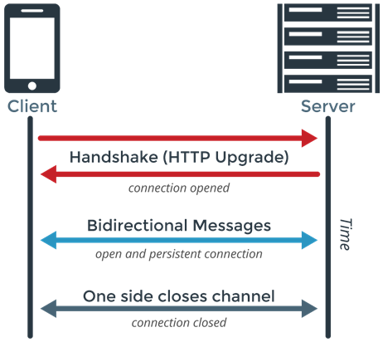
Our Goals
INTRODUCTION TO SOCKET
Web sockets are defined as a two-way communication between the servers and the clients, which mean both the parties, communicate and exchange data at the same time. This protocol defines a full duplex communication from the ground up. Web sockets take a step forward in bringing desktop rich functionalities to the web browsers. It represents an evolution, which was awaited for a long time in client/server web technology.

Slide 7
SYSTEM ANALYSIS
Our Goals
SYSTEM OBJECTIVES:-
Technical articles and Papers
Communication over a network I one field where this tool finds wide ranging application chat application . Chat application establishes a connection between 2 or more system connected over an intranet or ad-hoc This tool can be used for large scale communication and conferencing in an organization or campus of vast size, thus increasing the standard of co-operation. In addition it converts the complex concept of sockets to a user friendly environment. This software can have further potentials such as file transfer and voice chatting options that can be worked upon later.

Slide 8
Our Goals
Features
User Login
Chat Bot
Encryption
Push Notification
Cloud Synchronization

Slide 9
Our Vision
Project Modules
User Management Module
User Registration
User Validation
Change Password
Administration Module
Private Chat Module

Slide 10
Our Goals
Implementation Methodology
Tools & Technology
Topic oriented structure is provided below:
Software Analysis
Mind Map
Design Patterns
UML Techniques
Database Modelling Tools
MYSQL
Programming Languages:
HTML,CSS, PHP
Libraries:
Ratchat Library
IDE
VisualStudio Code
Version Control
Git/Github
Databases:
MYSQL
Web Design:
Bootstrap

Slide 11
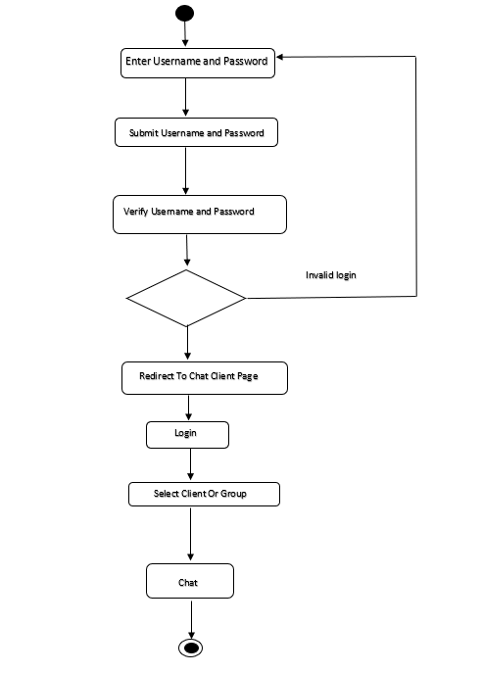
Control Flow Diagram
Our Goals

Slide 12
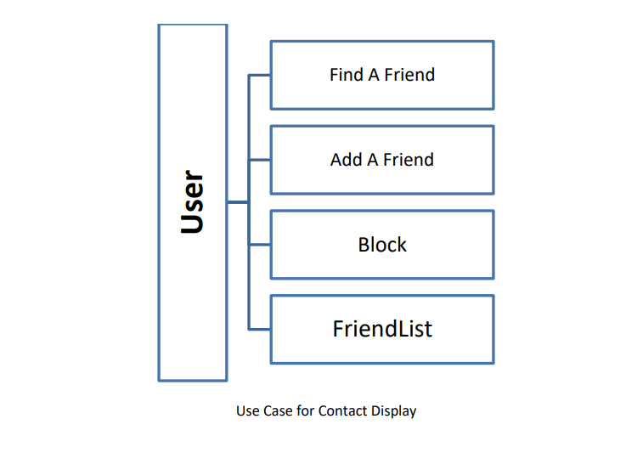
Our Goals
Use Case Diagram For Contact Display

Slide 13
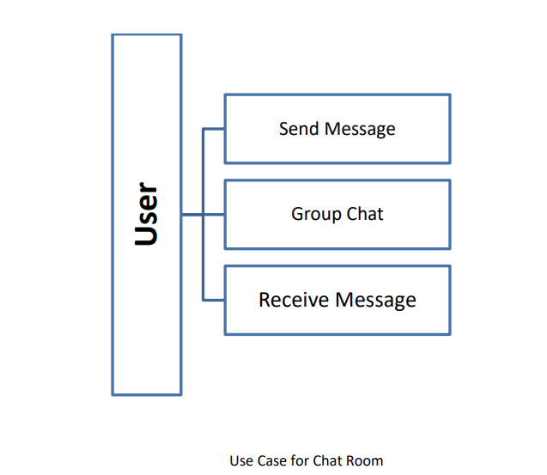
Our Goals
Use Case For Chat Room

Slide 14
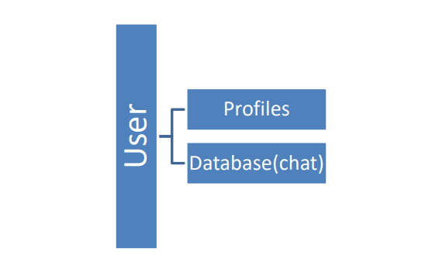
Our Goals
Use Case For maintenance

Slide 15
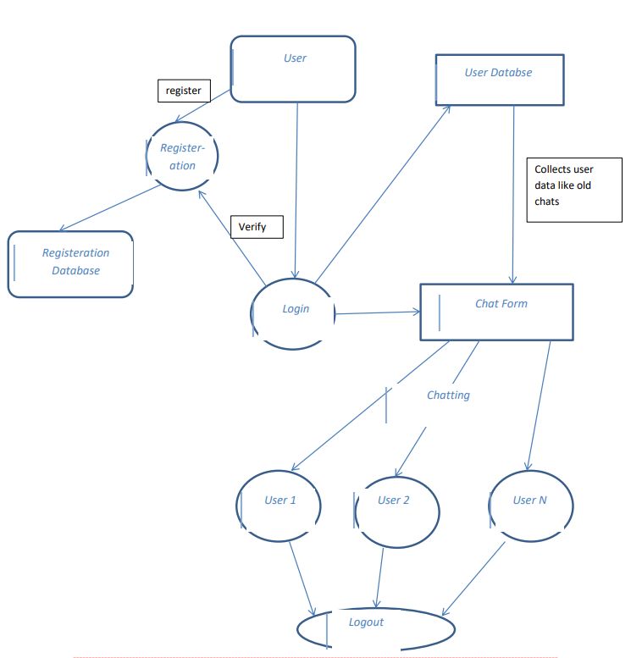
DFD Diagram
Our Goals

Slide 16
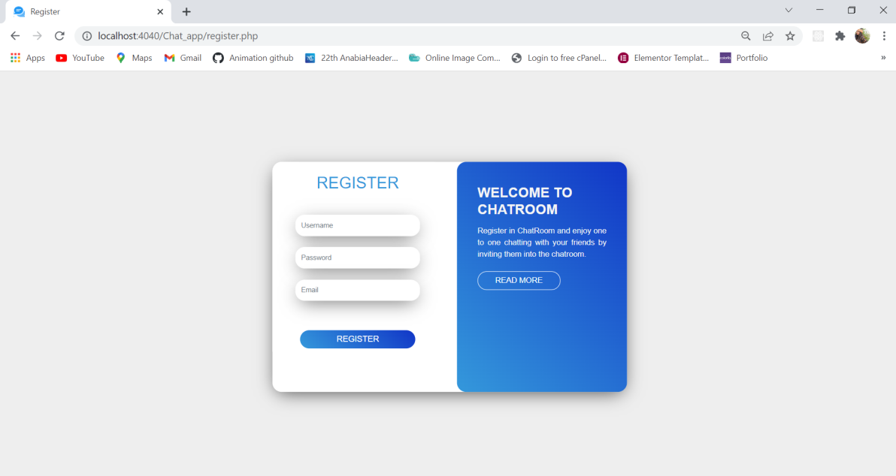
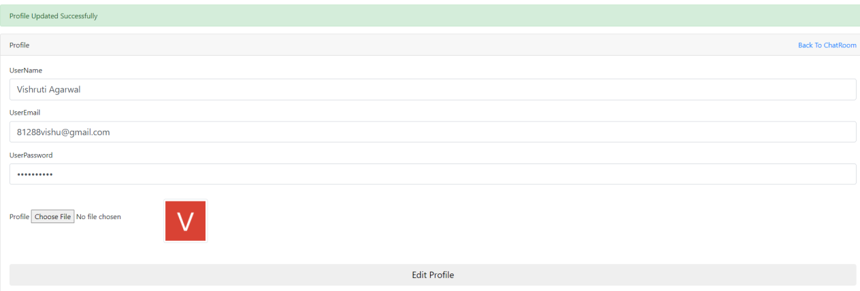
GUI
Our Goals
Register:
Profile Settings :

Slide 17
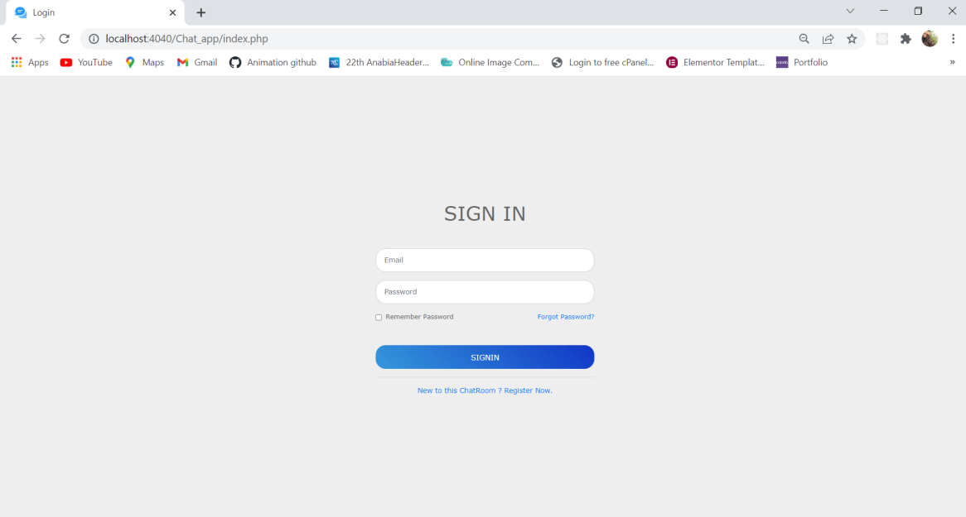
GUI
Our Goals
Login:
Profile Settings :

Slide 18
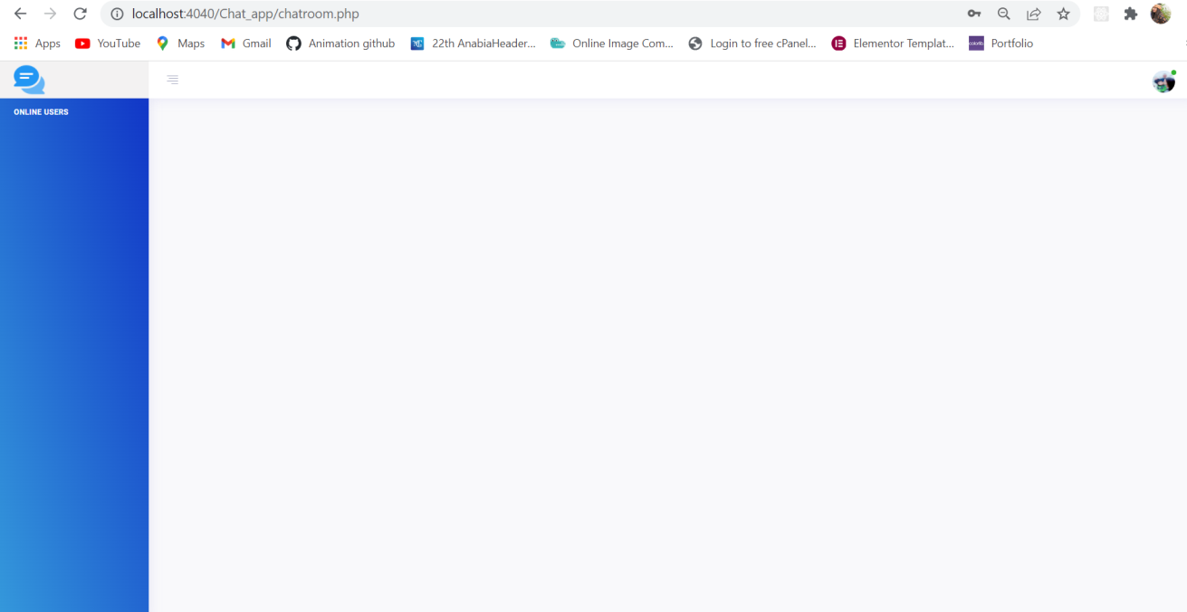
GUI
Our Goals
Chat Room :
Profile Settings :

Slide 19
GUI
Our Goals
Profile Settings :
Profile Settings :

Slide 20
Our Goals
References
Document No. | Document Title | Author
1 | Project Purpose & Requirements | Slideshare.net
2 | Policy Requirements | Google
3 | Error Debugging | Stack Overflow

Slide 21
THANK YOU.

